Slide 1
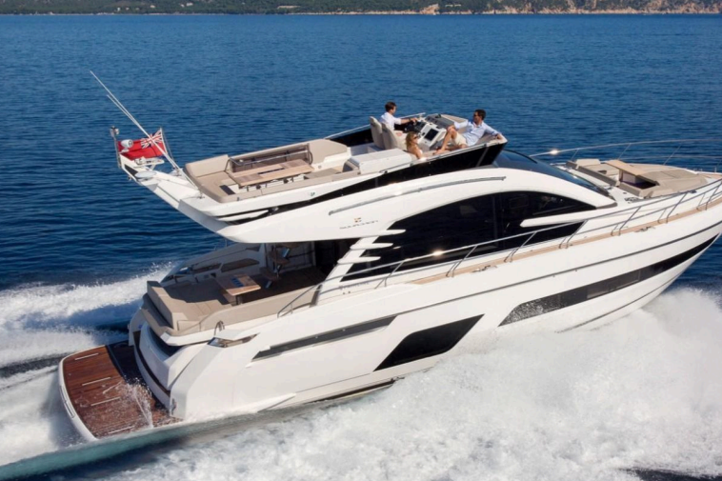
2019 Fairline Squadron 53
USD 1,100,000
Length Overall | 16.92 m (55 ft 6.1 in) | Engine | 2 x VOLVO PENTA D11-725
Beam | 4.52 m (14 ft 10 in) | Engine Hours | 177 HOURS
Draft | 1.19 m (3.9 ft ) | Drive Type | DIRECT DRIVE
Cabins | 5 (3 Guest + 2 Crew) | Fuel Tank | 2,412 [L] – 637 [US GAL]
Hull Material | FIBERGLASS | Water Tank | 550 [L] – 145 [US GAL]
Location | HONG KONG | Builder | FAIRLINE YACHTS

Slide 2
The Fairline Squadron 53 is a luxury British flybridge motor yacht that combines elegant styling, spacious accommodation, and strong performance. Built by Fairline Yachts, the Squadron 53 features contemporary exterior lines designed by Alberto Mancini and offers generous indoor and outdoor living spaces ideal for cruising and entertaining.
At 16.92 meters (55 ft 6 in) in length with a 4.52-meter (14 ft 10 in) beam, the yacht provides a bright and spacious saloon with panoramic windows, a fully equipped galley, and seamless access to the aft cockpit. The large flybridge includes ample seating, sunbathing areas, and an outdoor helm station, creating an excellent social space for guests.
Below deck, the standard layout accommodates up to six guests in three luxurious cabins, including a full-beam master suite, a forward VIP cabin, and a twin guest cabin. High-quality materials, handcrafted joinery, and premium finishes throughout reflect Fairline's reputation for craftsmanship.
Powered by twin Volvo Penta diesel engines, the Squadron 53 delivers comfortable cruising performance, responsive handling, and excellent offshore capability. With fuel capacity of approximately 2,412 liters (637 US gallons) and freshwater capacity of approximately 550 liters (145 US gallons), it is well suited for extended coastal cruising and family adventures.

Slide 3
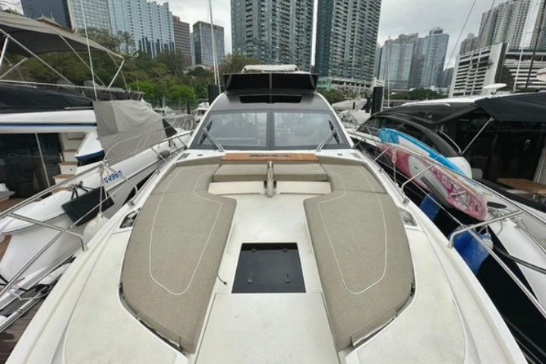
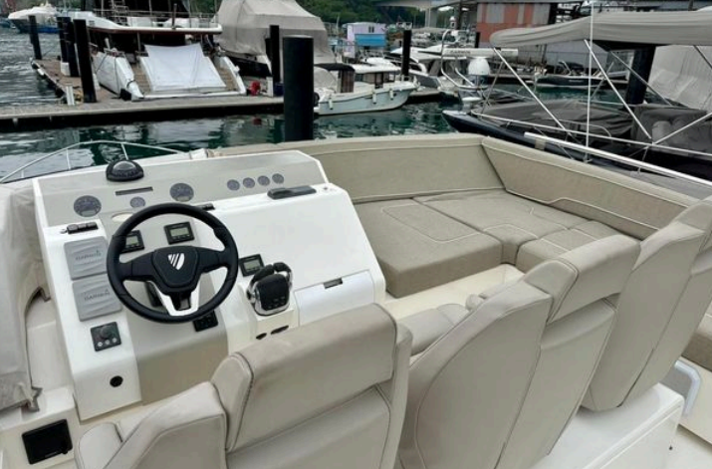

Slide 4
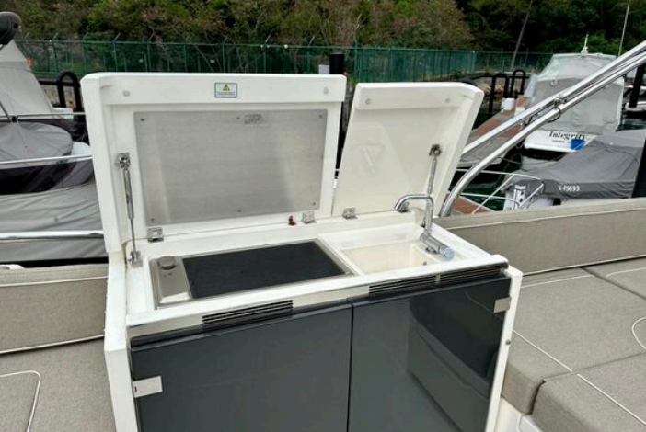
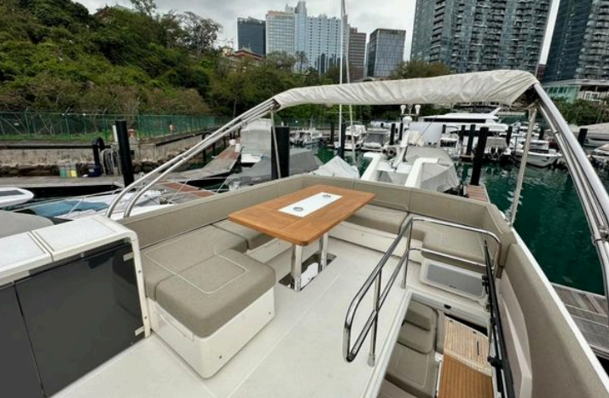

Slide 5
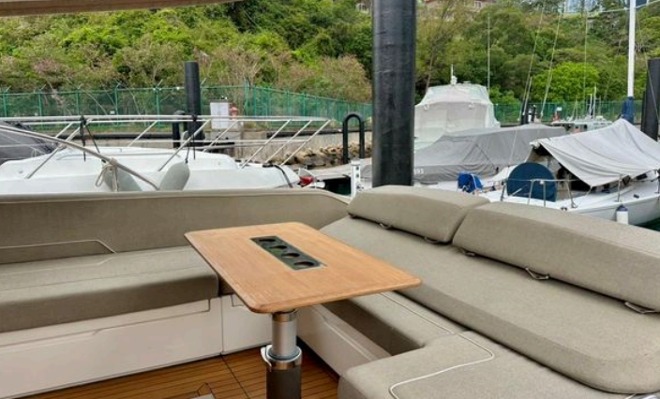
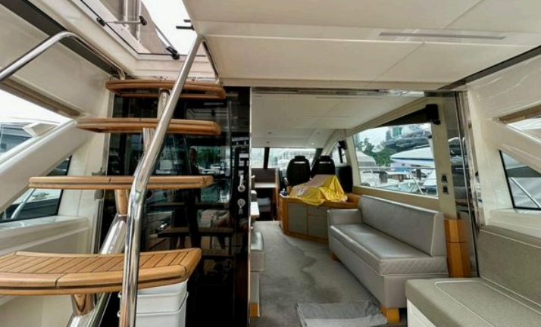

Slide 6
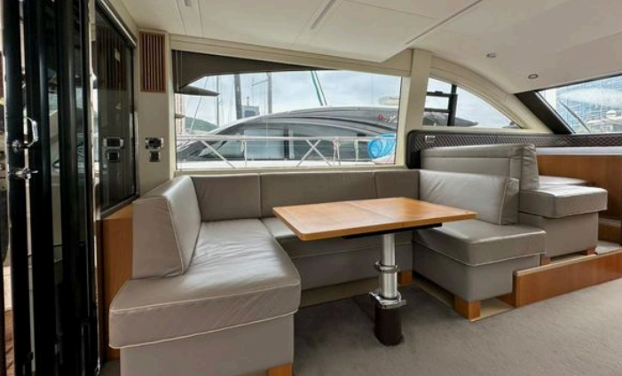
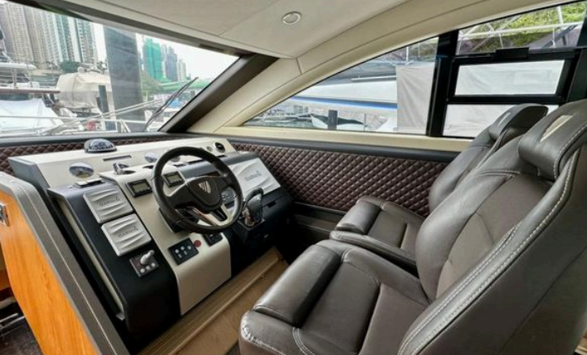

Slide 7
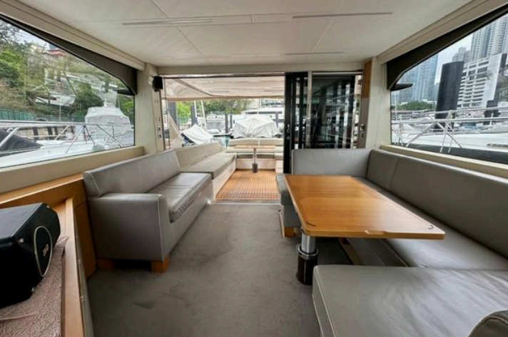
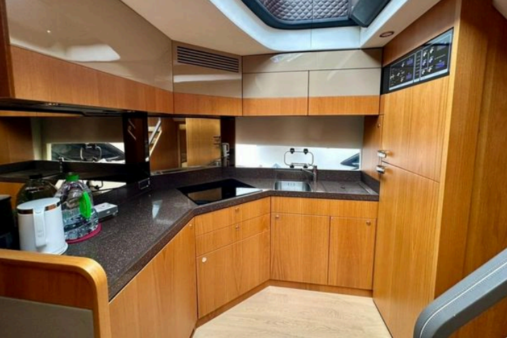

Slide 8
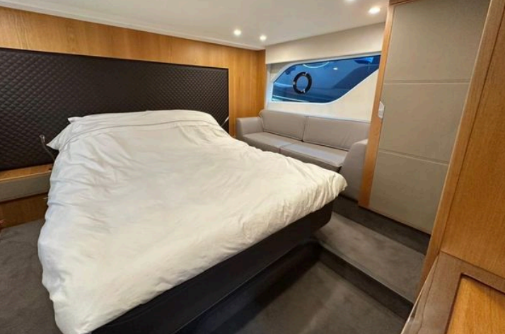
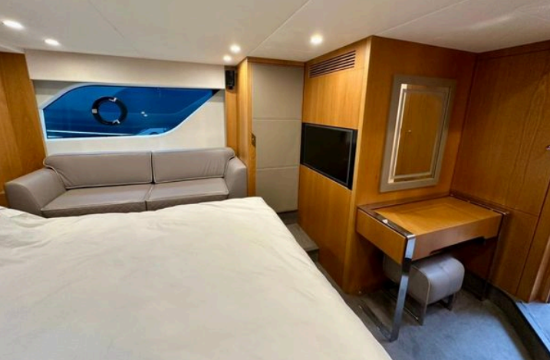

Slide 9
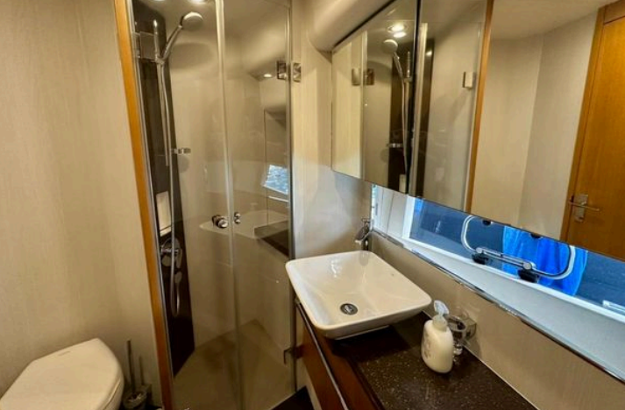
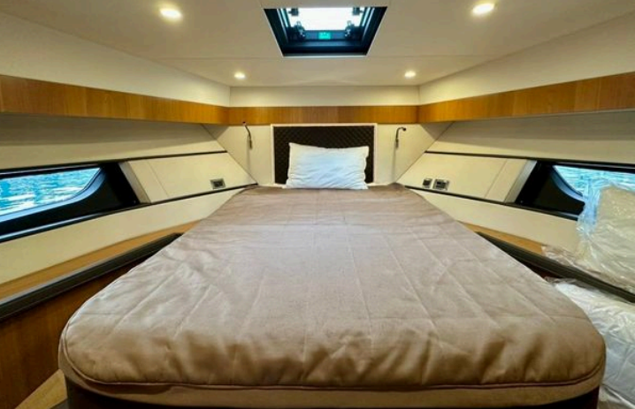

Slide 10
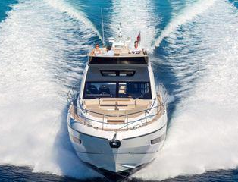

Slide 11

This document is not contractual. Any information provided by the company on their website, brochure and any other related documentation is provided in good faith and offered for information purposed only and the company do not make any representation, warrant or assume any legal liability or responsibility whatsoever, express or implied, for the accuracy, adequacy, validity, reliability, availability, completeness or usefulness of any information and/or images displayed. Yacht inventory, sales and / or charter prices, and any other specifications are subject to changes at any time without prior notice. None of the text and/or image used in this brochure may be reproduced without written consent from the company.

