Slide 1
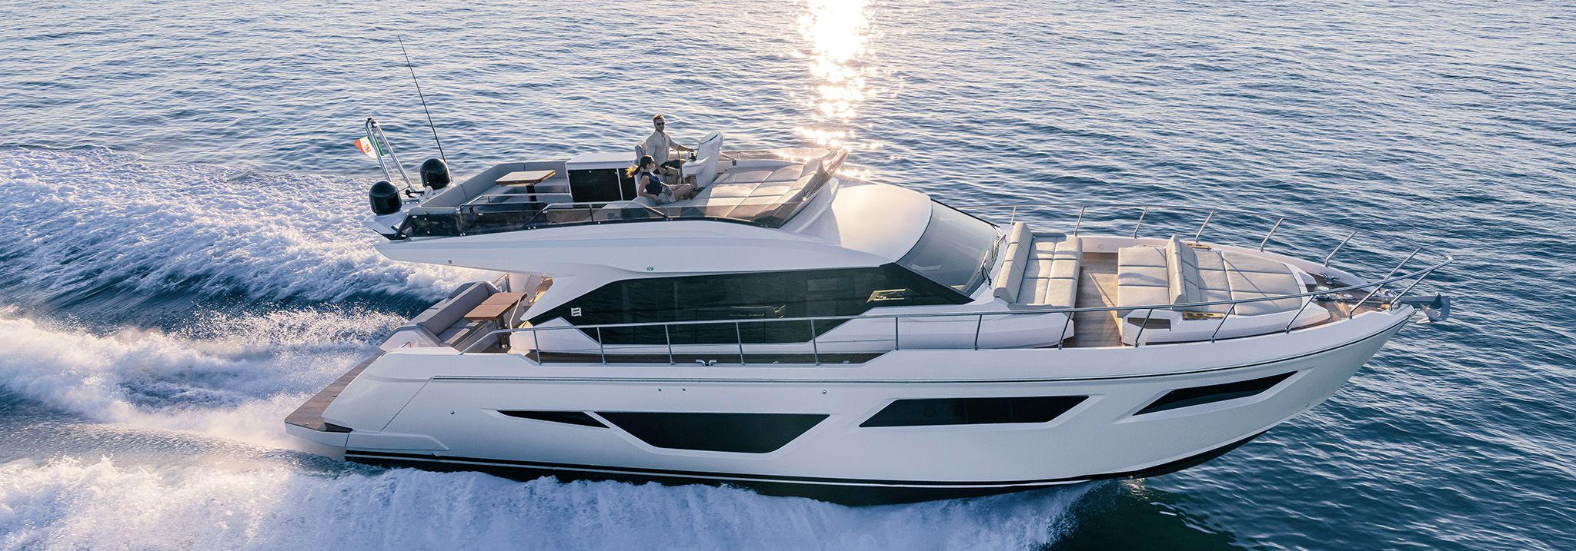
2024 Ferretti Yachts 580
EURO 2,078,689
Specification
Length Overall | 18.24 m (59 ft 10 in) | Engine | 2 x VOLVO PENTA D13 1000 hp
Beam | 5.0 m (16 ft 5 in) | Engine Hours | 273 Hours
Draft | 1.50 m (16 ft 5 in) | Drive Type | SHAFT DRIVE
Cabins | 3 Master-Class Suites | Fuel Tank | 3,250 [L] – 859 [US GAL]
Hull Material | FIBERGLASS | Water Tank | 700 [L] – 185 [US GAL]
Location | PHUKET,THAILAND | Builder | FERRETTI YACHTS

Slide 2
Description
Step aboard the Ferretti Yachts 580 and discover a world where Italian elegance meets the freedom of the sea. Designed for those who value both adventure and refinement, the yacht offers expansive outdoor living spaces and interiors crafted with contemporary sophistication.
From sunrise gatherings on the flybridge to sunset dinners in the saloon, every detail invites guests to relax and indulge. The seamless connection between interior and exterior spaces creates an atmosphere of openness, while the refined décor reflects Ferretti’s unmistakable style.
More than a vessel, the FY580 is a statement of lifestyle, blending performance, comfort, and luxury into unforgettable journeys.
Key Features
        Expansive flybridge for socializing and panoramic views
        Elegant saloon with natural light and modern décor
        Seamless indoor–outdoor living design
        Luxurious master suite with refined finishes
        Contemporary Italian styling throughout
        Designed for both relaxation and exhilarating cruising

Slide 3
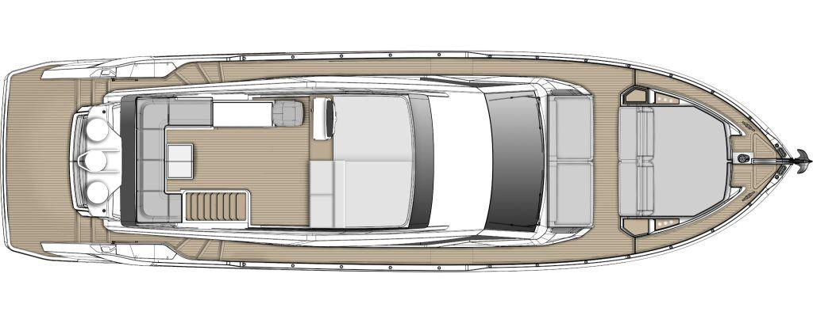
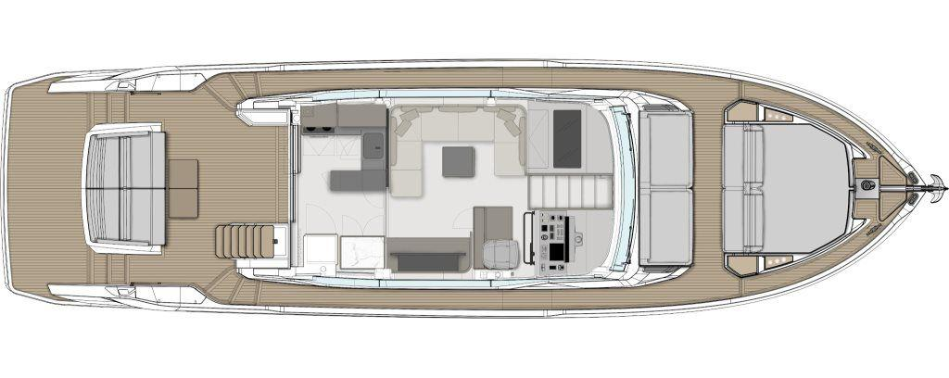
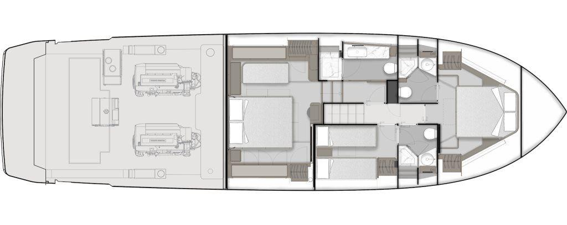
General Arrangement
SUN DECK
MAIN DECK
LOWER DECK

Slide 4
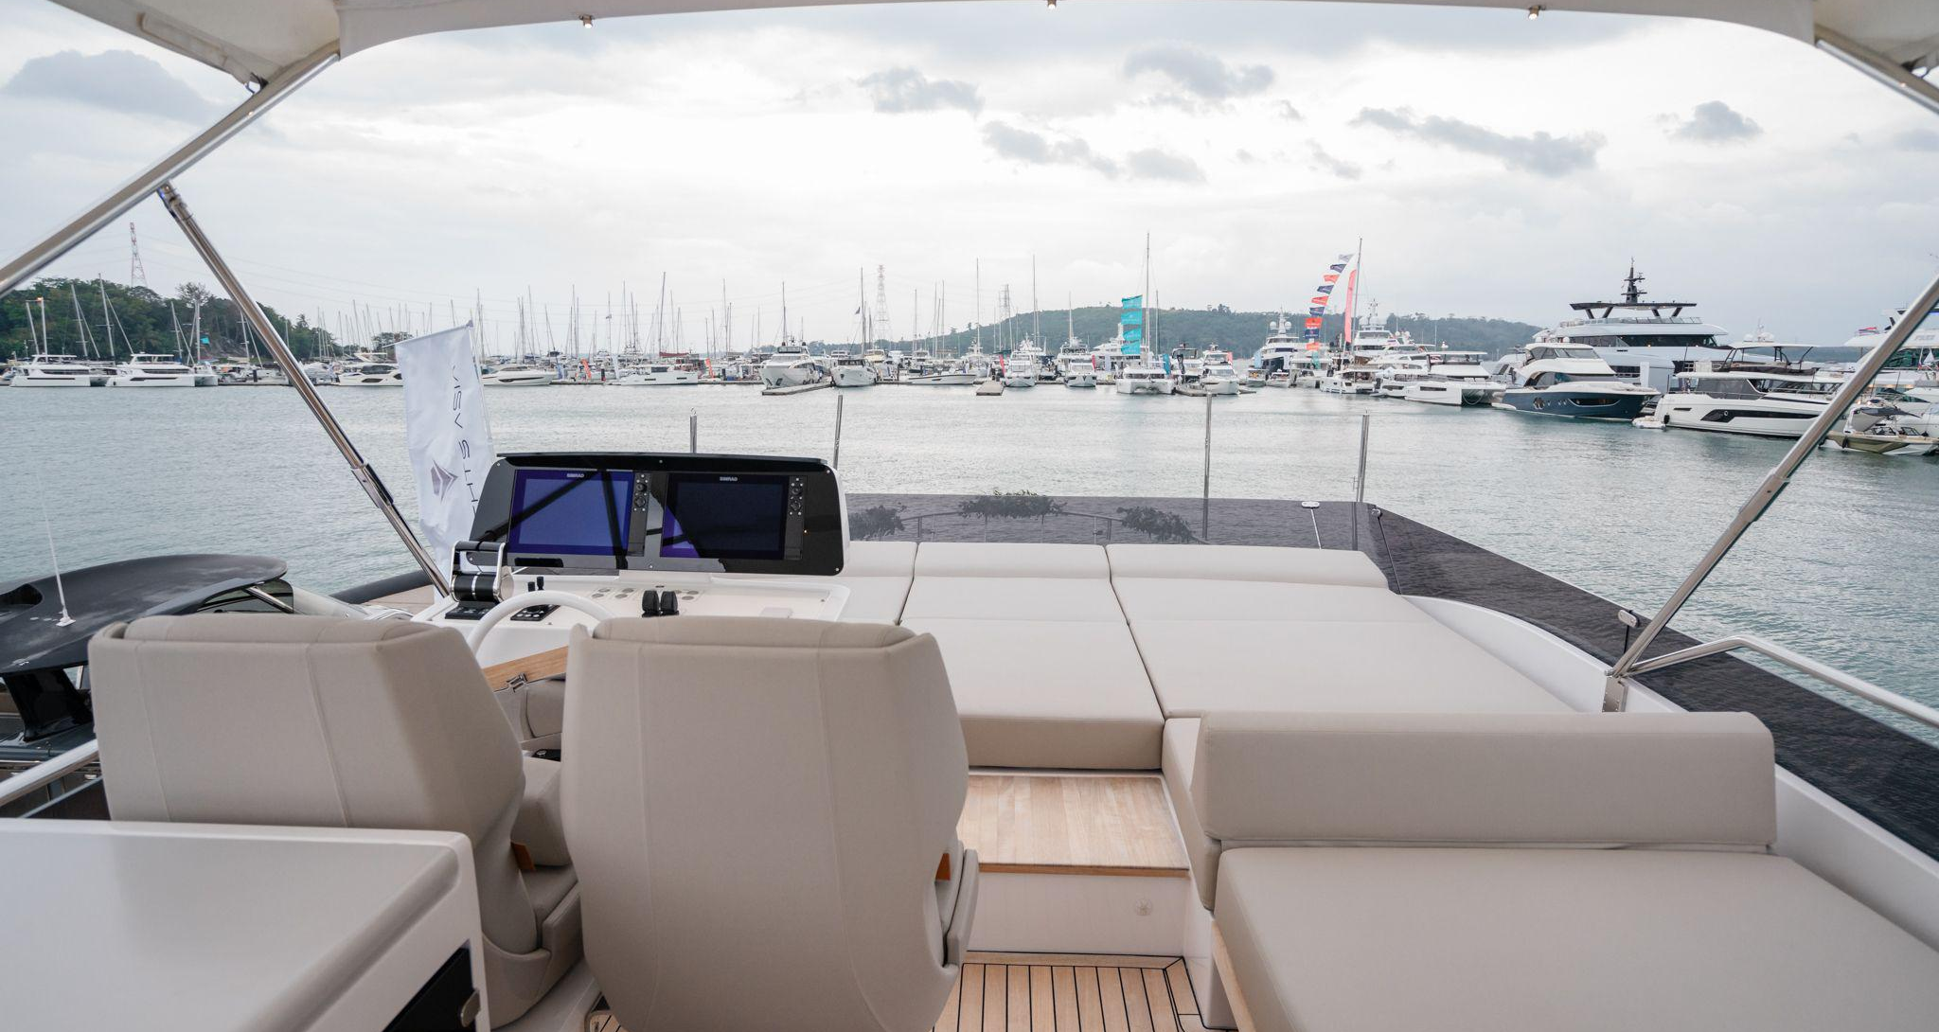
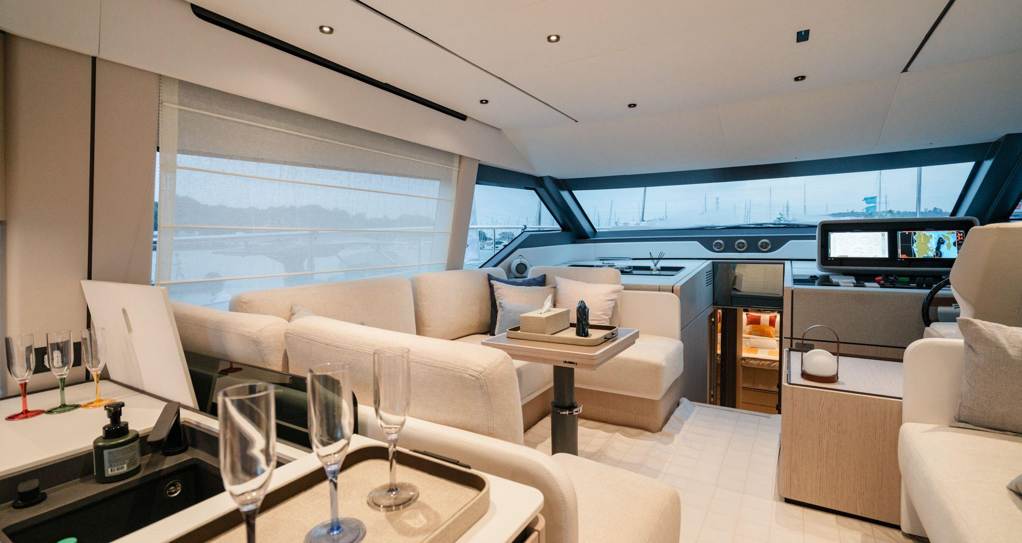

Slide 5
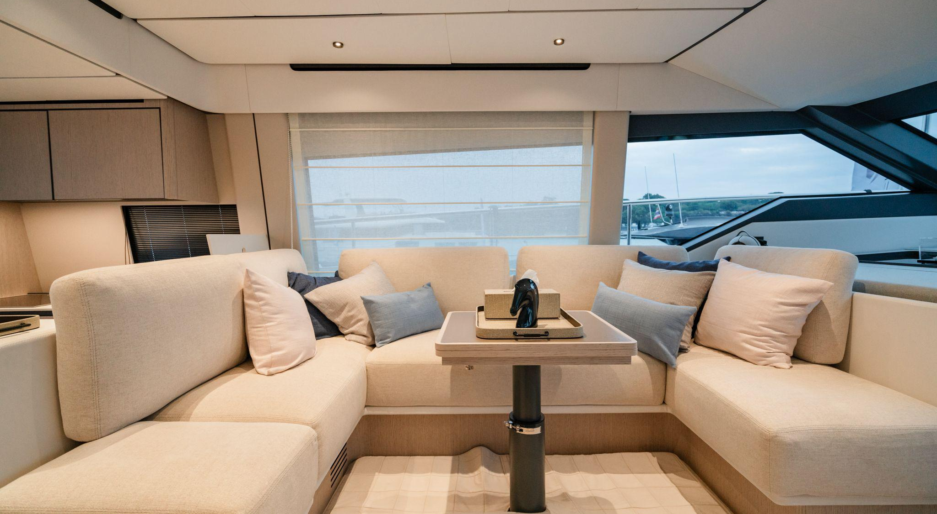
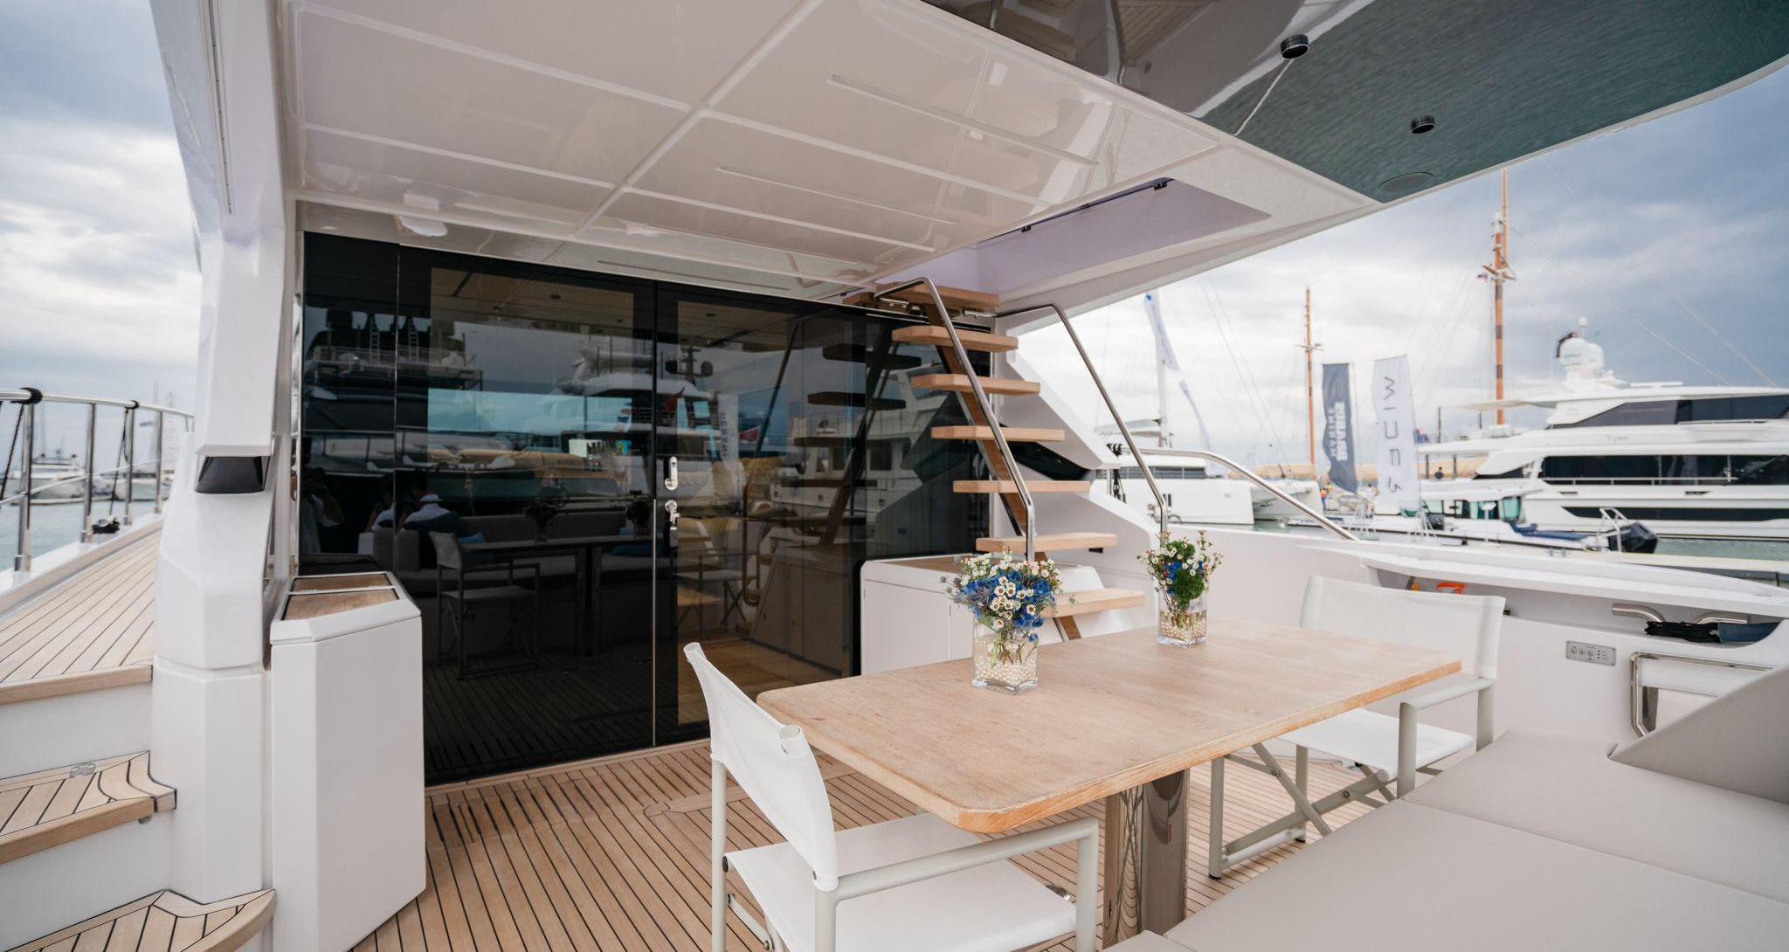

Slide 6
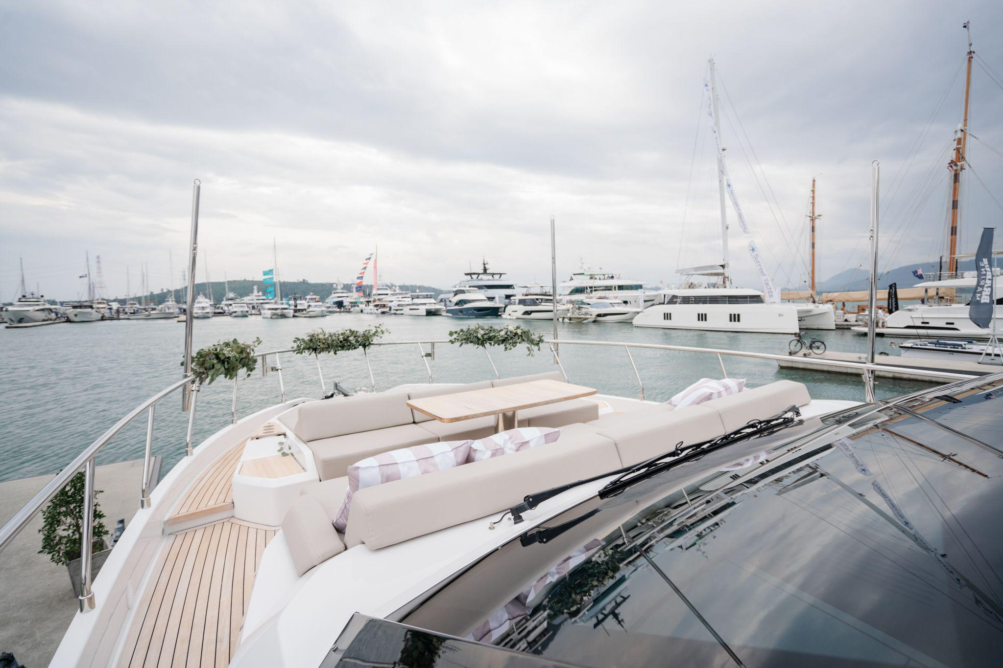
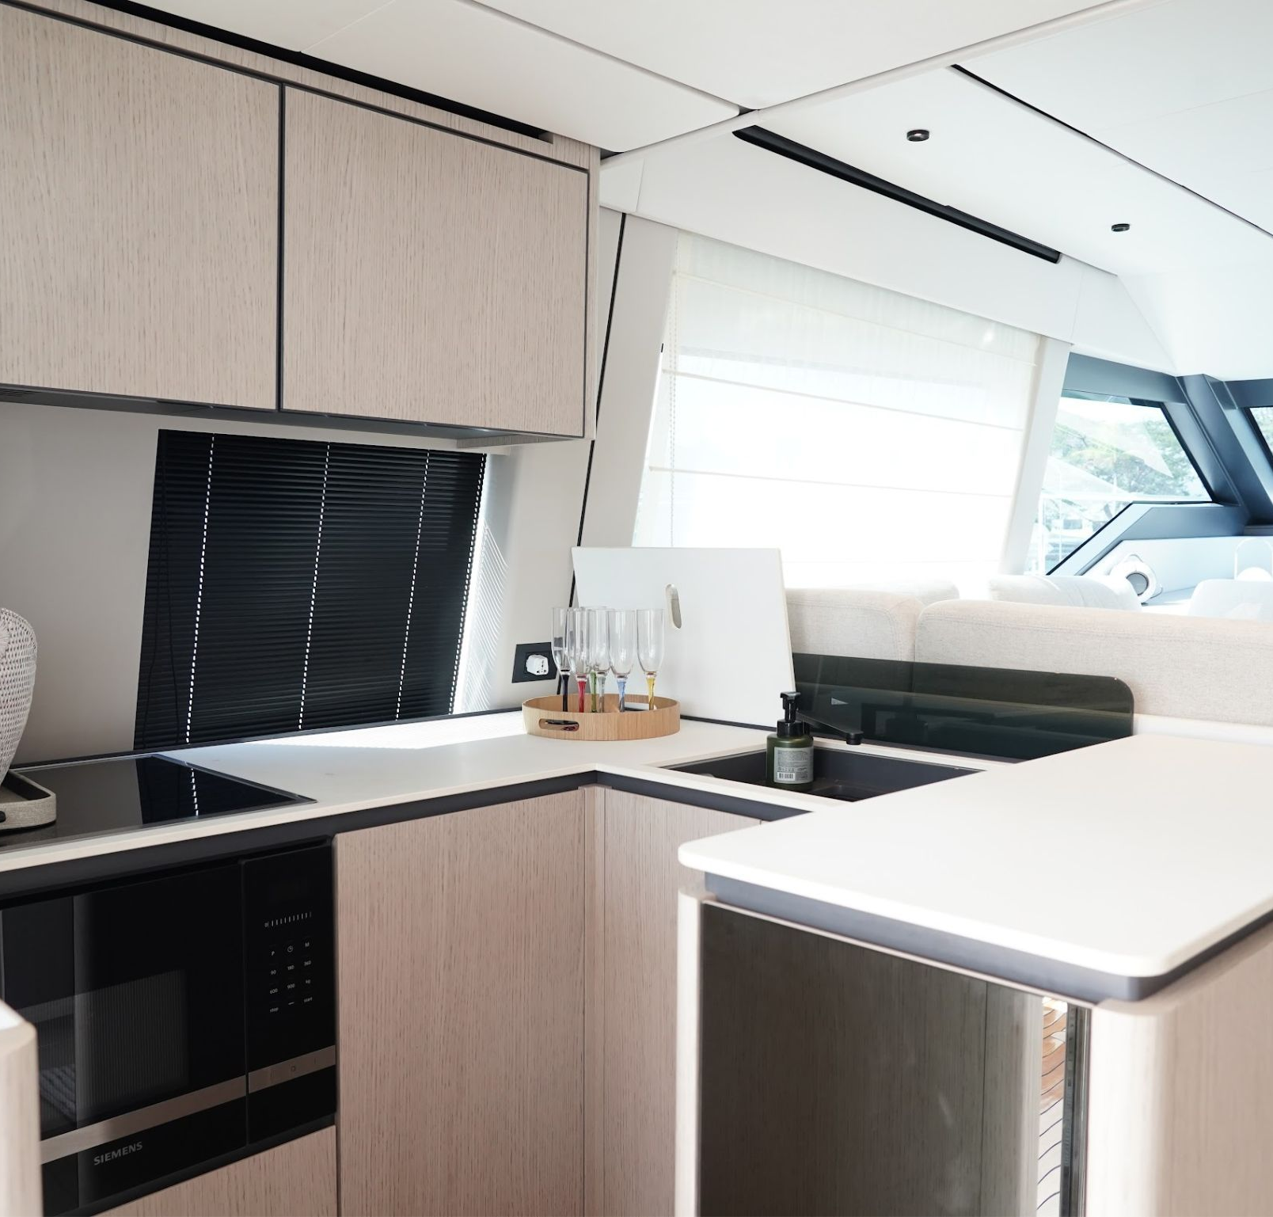
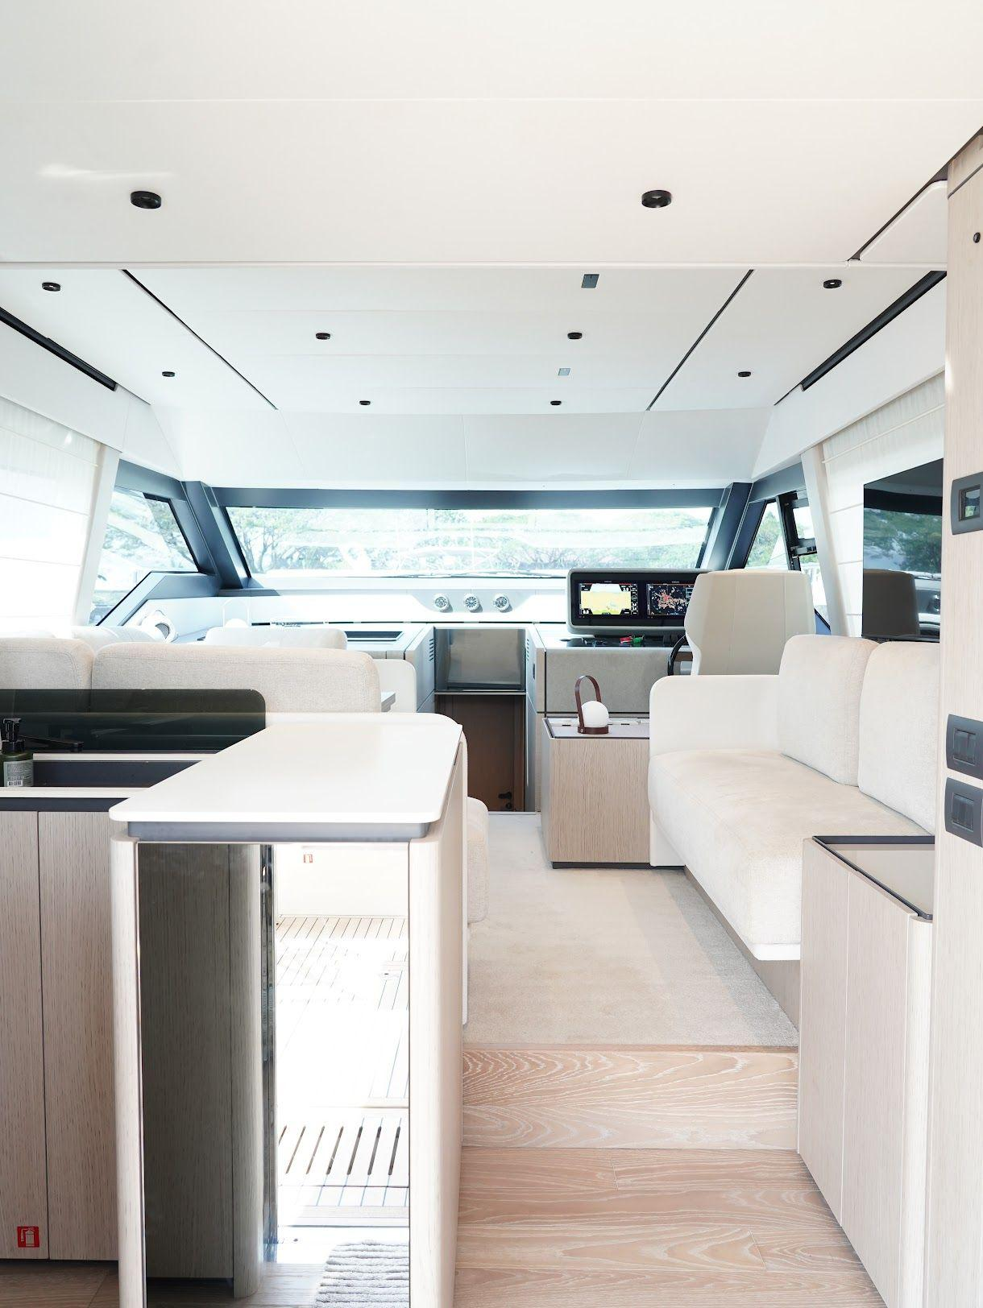

Slide 7
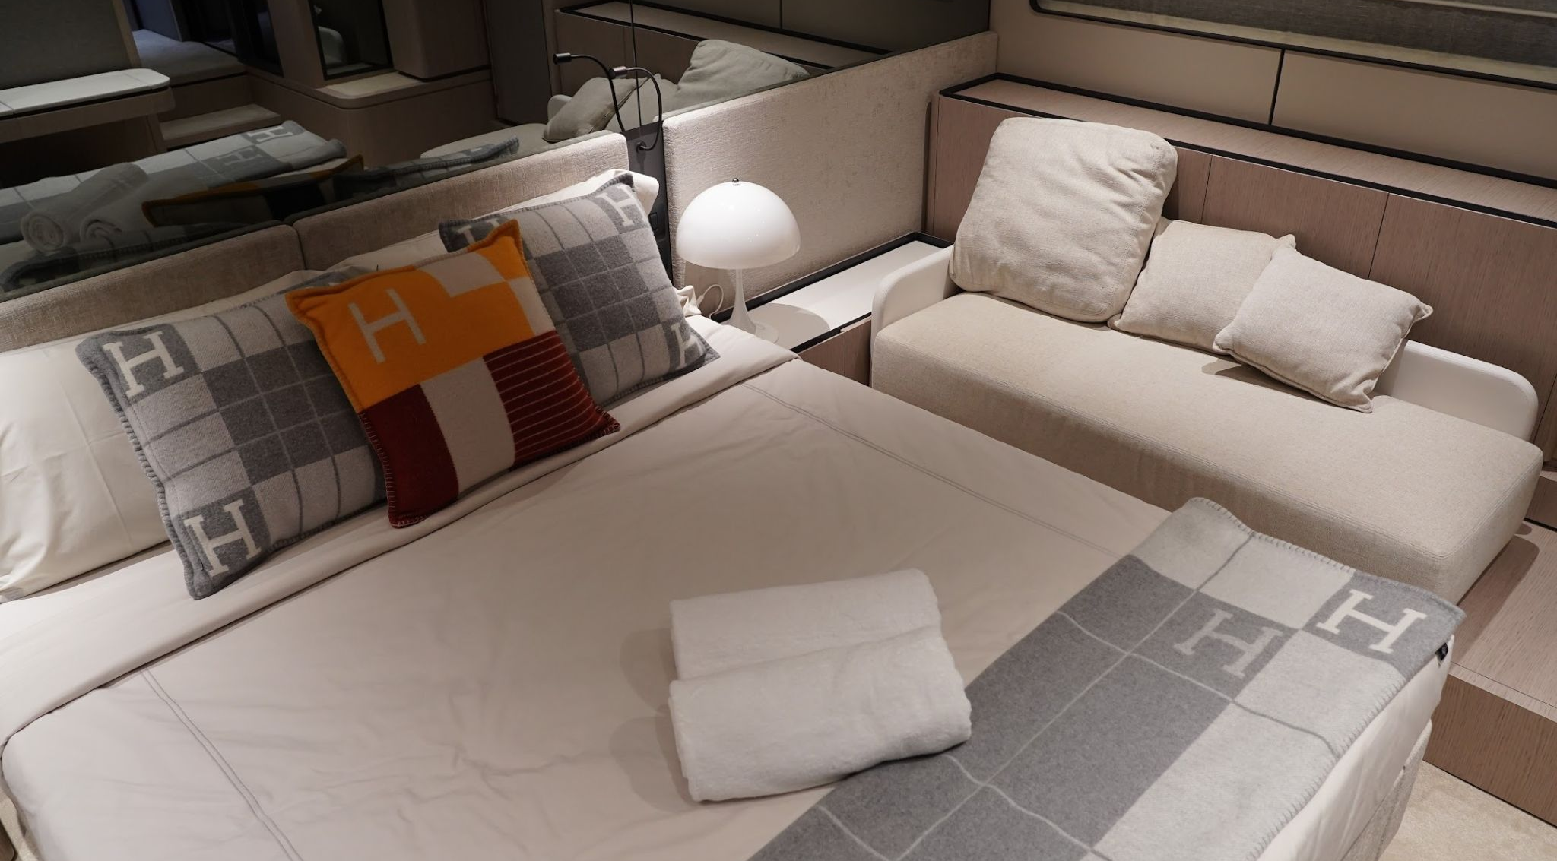
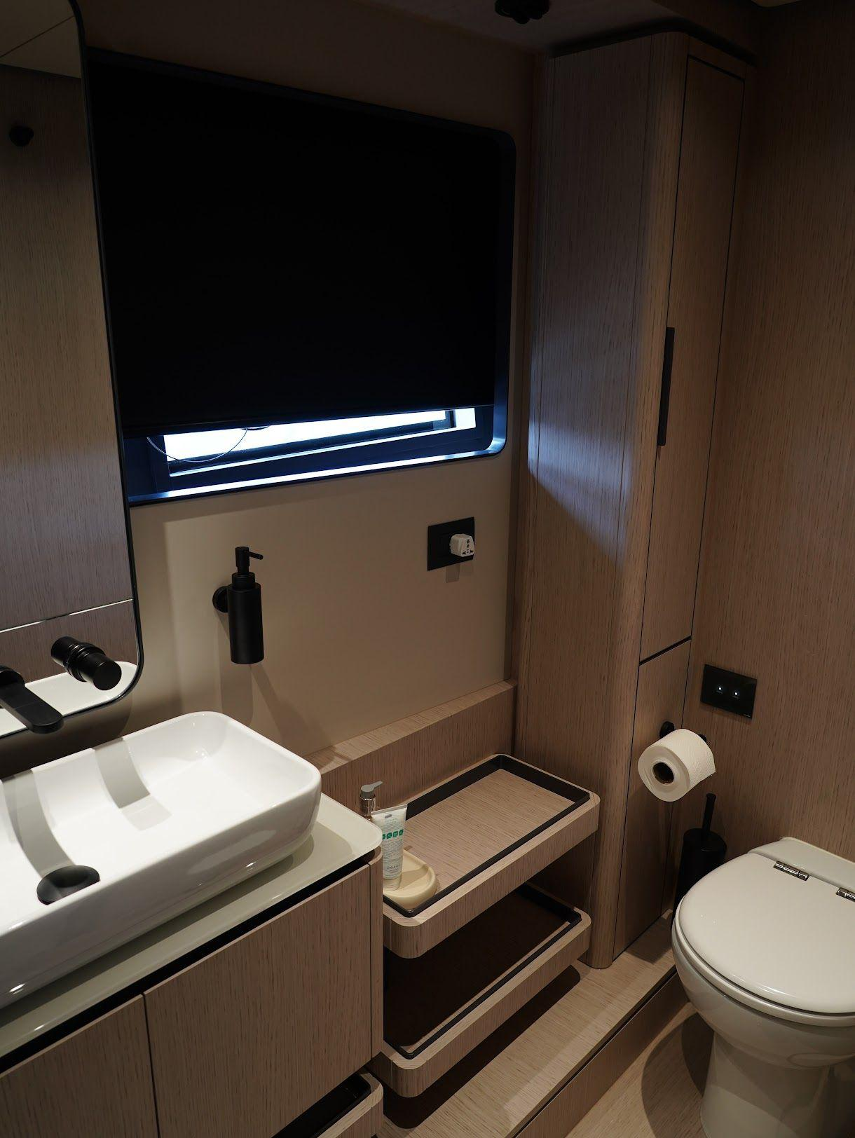

Slide 8
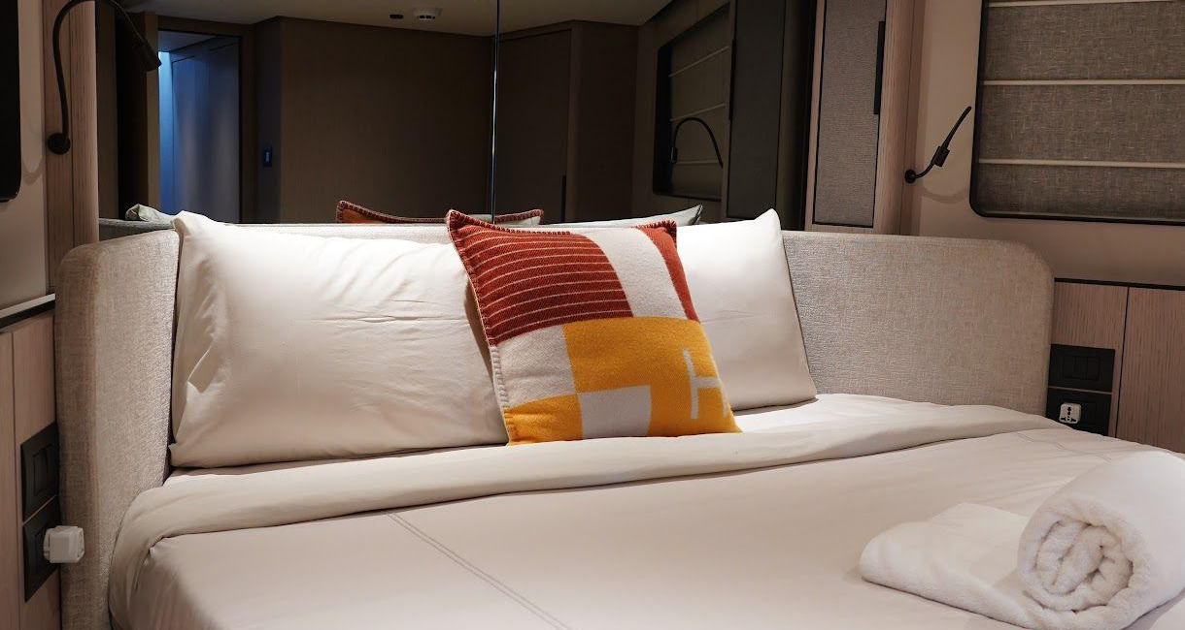
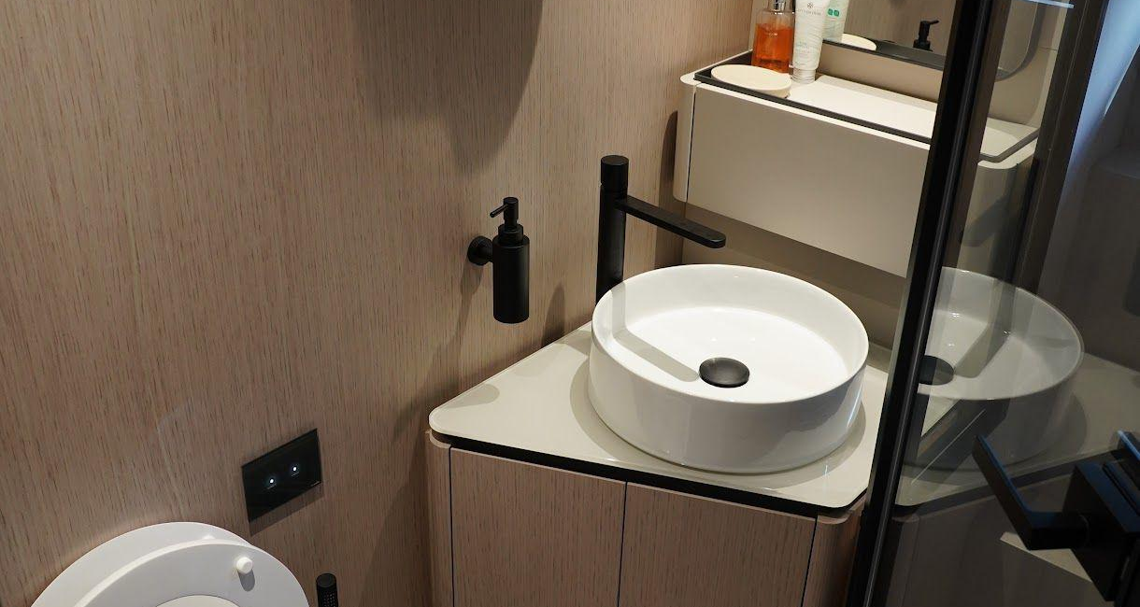

Slide 9
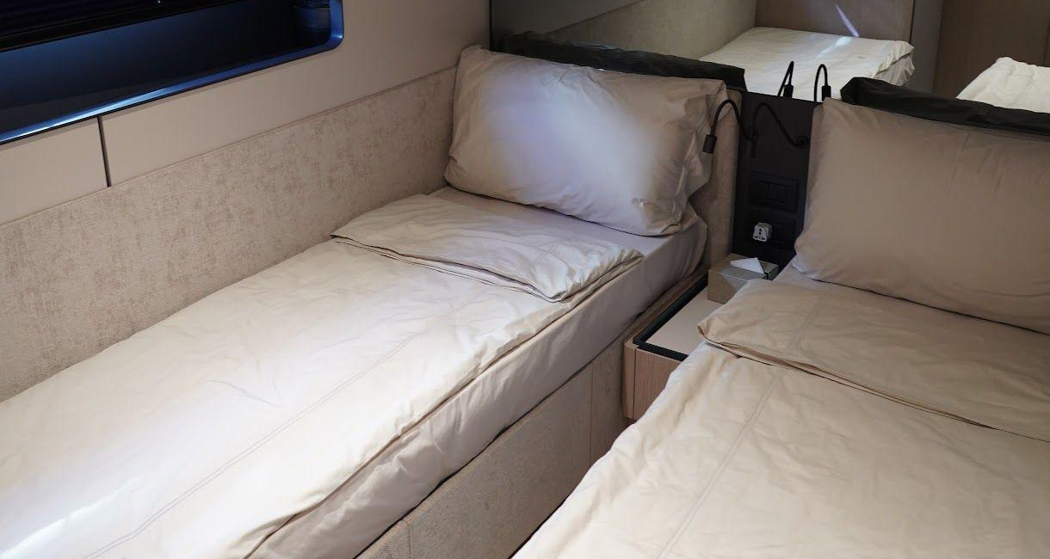
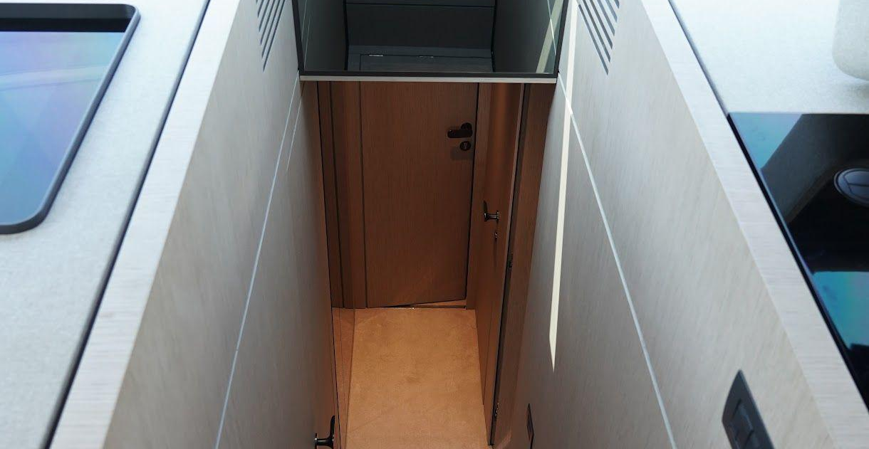

Slide 10
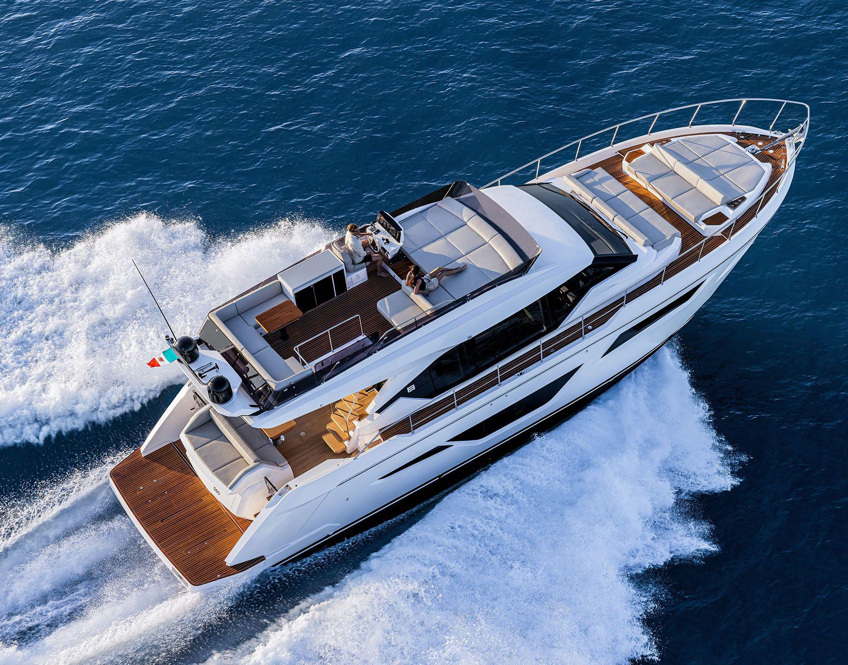

PEN MARINE SDN. BHD. IS THE REGISTERED AGENT OF THE
LANGKAWI INTERNATIONAL YACHT REGISTRY (LIYR)
New Yacht Registration (Private & Commercial), Entity Registration, Ownership Transfer, Yacht Name Change, Annual Tonnage Renewal, Deletion Certificate

Slide 11

This document is not contractual. Any information provided by the company on their website, brochure and any other related documentation is provided in good faith and offered for information purposed only and the company do not make any representation, warrant or assume any legal liability or responsibility whatsoever, express or implied, for the accuracy, adequacy, validity, reliability, availability, completeness or usefulness of any information and/or images displayed. Yacht inventory, sales and / or charter prices, and any other specifications are subject to changes at any time without prior notice. None of the text and/or image used in this brochure may be reproduced without written consent from the company.

