Slide 1
2023 Sanlorenzo SD126
USD 14,995,000
Specification
Length Overall | 38.40 m (126 ft 0 in) | Engine | 2 x CATERPILLAR 1600HP
Beam | 7.54 m (24 ft 9 in) | Engine Hours | 1,335 Hours
Draft | 2.21 m (7 ft 3 in) | Drive Type | SHAFT DRIVE
Cabins | 9 (5 GUEST + 4 CREW) | Fuel Tank | 33122.34 [L] – 8,750 [US GAL]
Hull Material | COMPOSITE | Water Tank | 6056.55 [L] – 1,600 [US GAL]
Location | FORT LAUDERDALE, FLORIDA | Builder | SANLORENZO

Slide 2
Description
The 2023 Sanlorenzo SD126, available for viewing in Fort Lauderdale, combines Francesco Paszkowski’s design with Marty Lowe interiors, featuring pale woods, neutral tones, and abundant natural light. Blending advanced technology with refined craftsmanship, she is in turn-key condition with Platinum warranties, fresh bottom paint (Oct 2025), new exterior cushions, and a ceramic coating.
Key Features:
Luxurious Accommodations
Sleeps 10 guests in 5 staterooms, including a full-beam main-deck Owner’s suite with private study and marble en-suites. A dedicated upper-deck VIP and three lower-deck guest cabins (two kings and one convertible queen) each feature en-suites and elegant finishes.
Expansive Outdoor Living
A triple-deck layout offers two Jacuzzis, ample sunbathing areas, a flybridge bar, al fresco dining for 10, and a fold-down salon balcony with panoramic views.
Expansive Outdoor Living
A triple-deck layout offers two Jacuzzis, ample sunbathing areas, a flybridge bar, al fresco dining for 10, and a fold-down salon balcony with panoramic views.
Performance and Systems
Powered by twin Caterpillar C32 Acert 1,600 hp engines, with CMC stabilizers, tropical A/C, dual water-makers, Hamann treatment system, and U.S. electrical spec with duty paid for effortless operation.
Crew and Practicality
Accommodates 8 crew in 4 cabins with a professional galley, advanced Furuno navigation suite, and RINA-class safety standards.
  Overall, Glory blends elegance and functionality, ready for family cruising or entertaining.

Slide 3
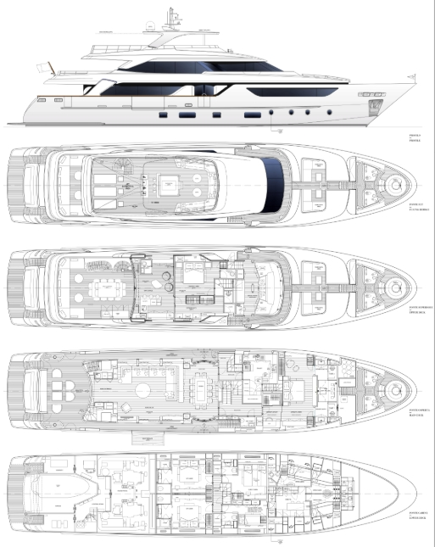
General Arrangement

Slide 4
General Arrangement
PROFILE
FLYING BRIDGE
UPPER DECK

Slide 5
General Arrangement
MAIN DECK
LOWER DECK

Slide 6
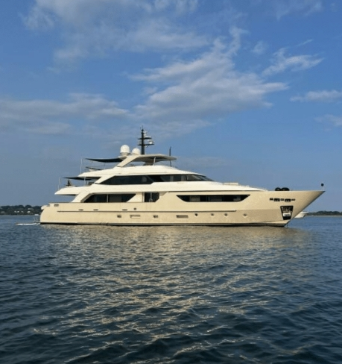

Slide 7
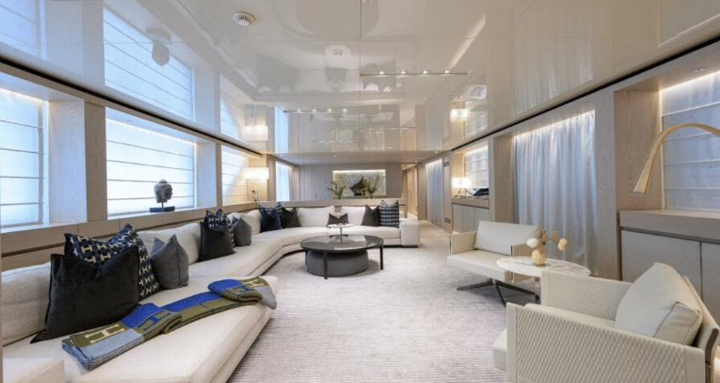
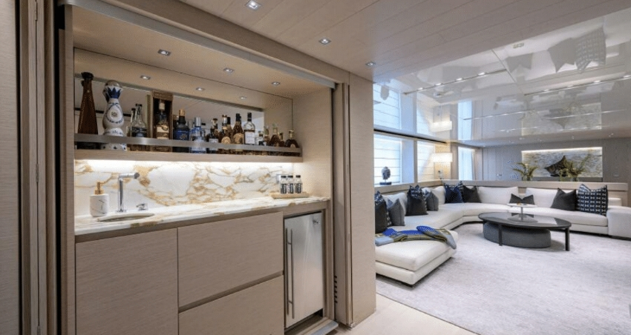

Slide 8
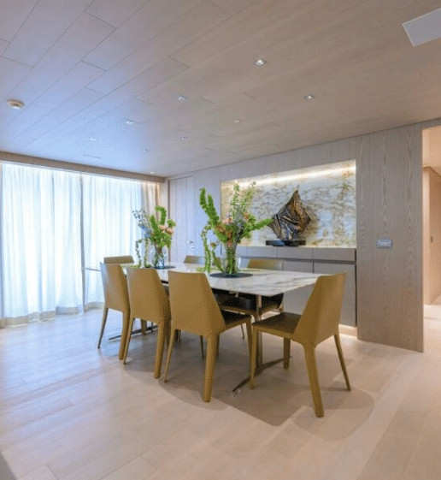
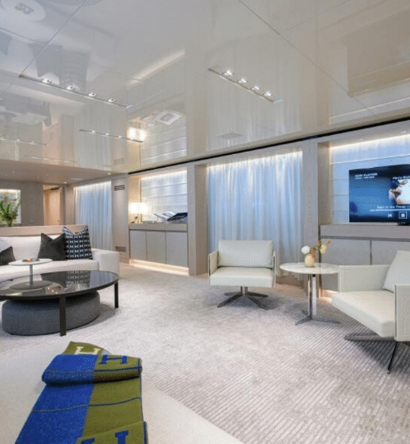
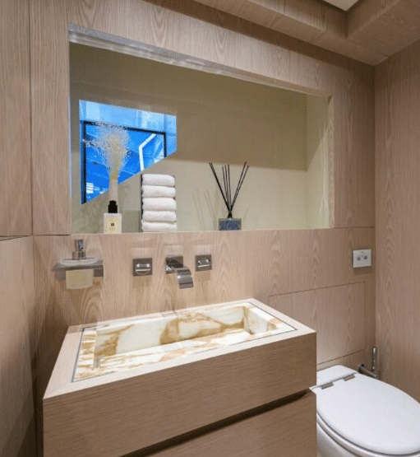
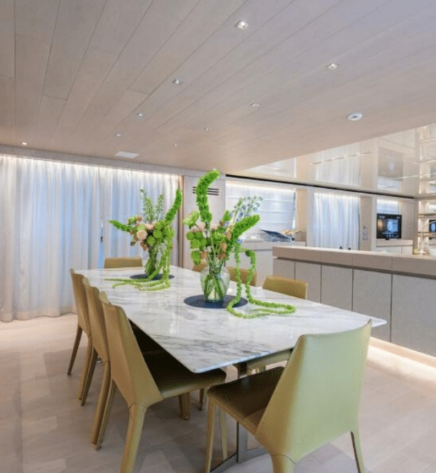

Slide 9
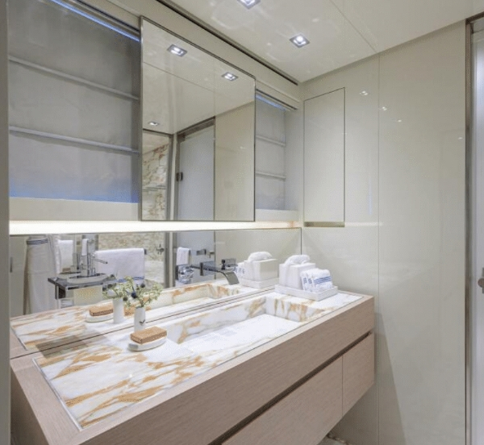
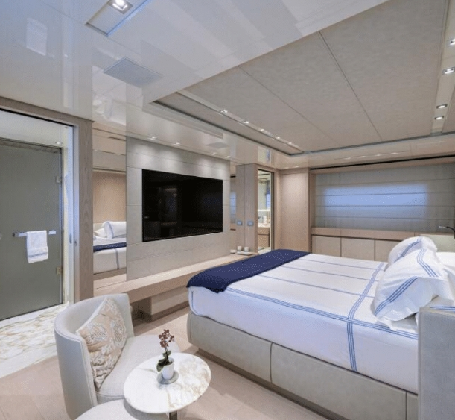
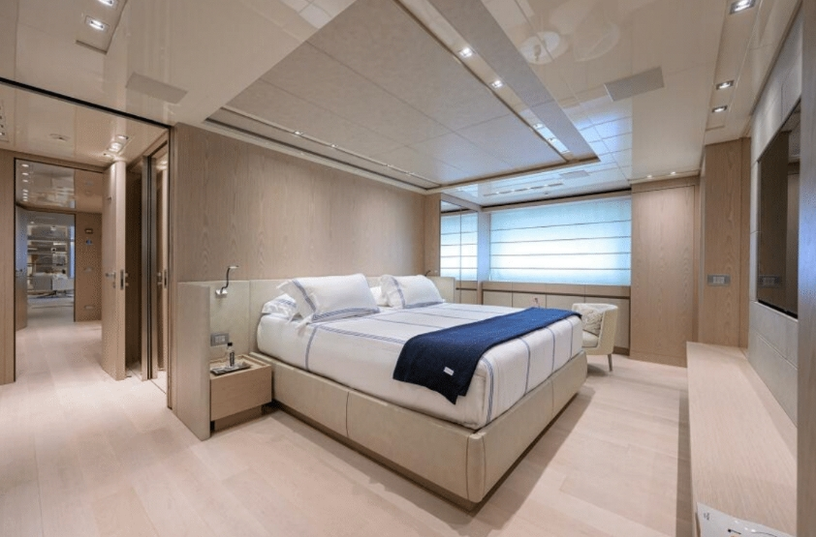

Slide 10
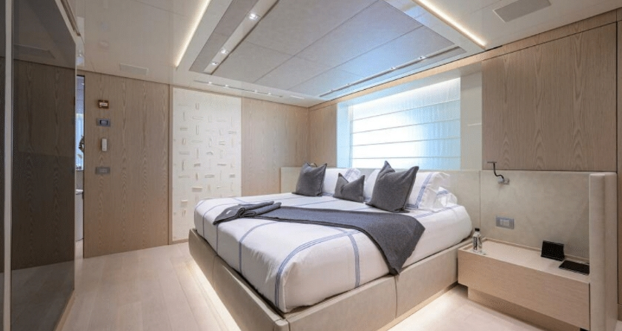
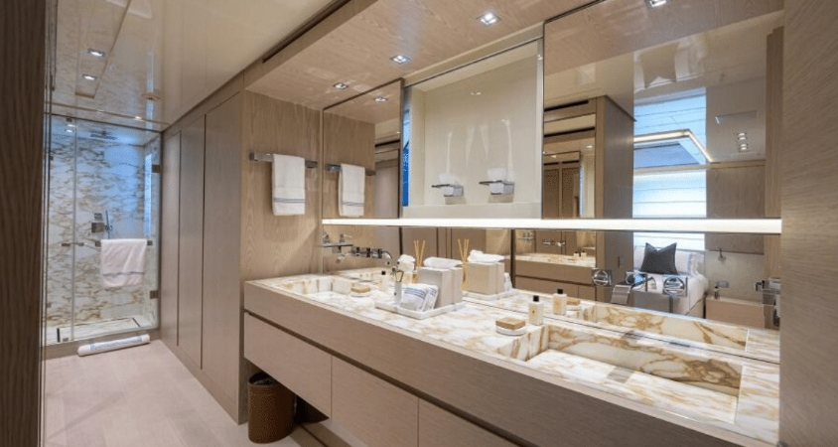

Slide 11
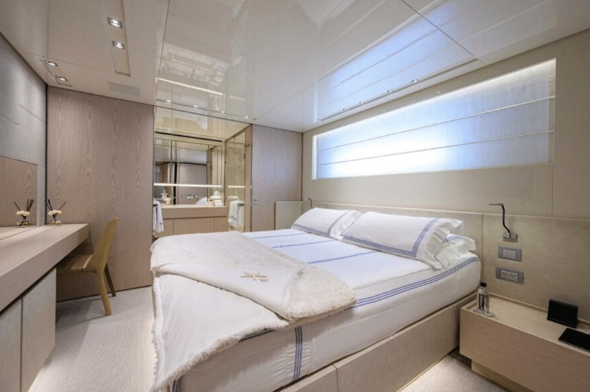
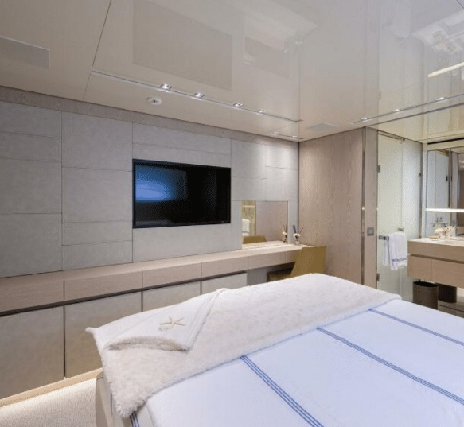
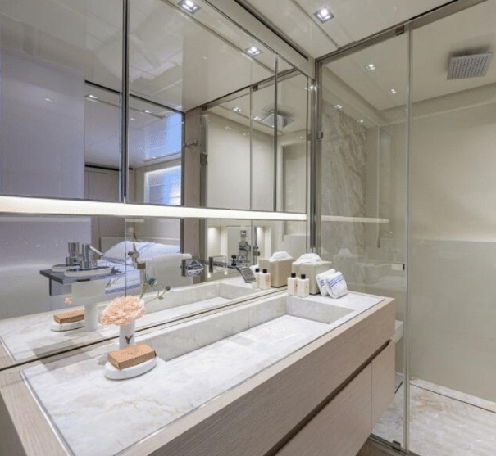

Slide 12
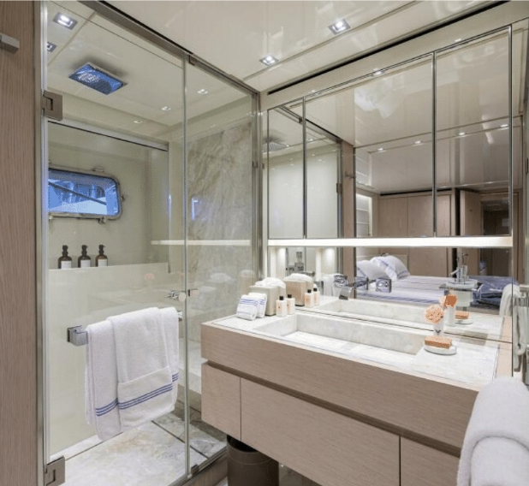
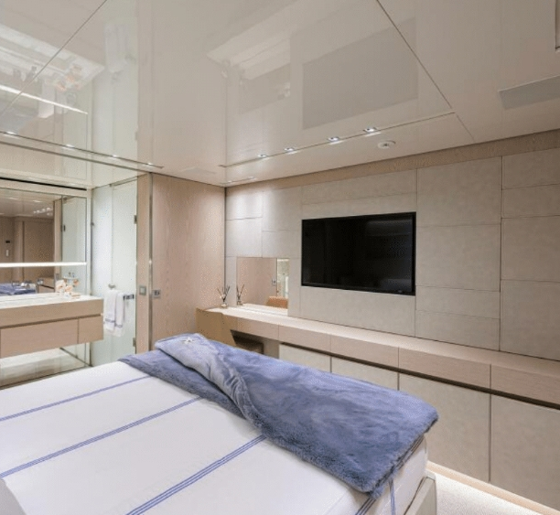
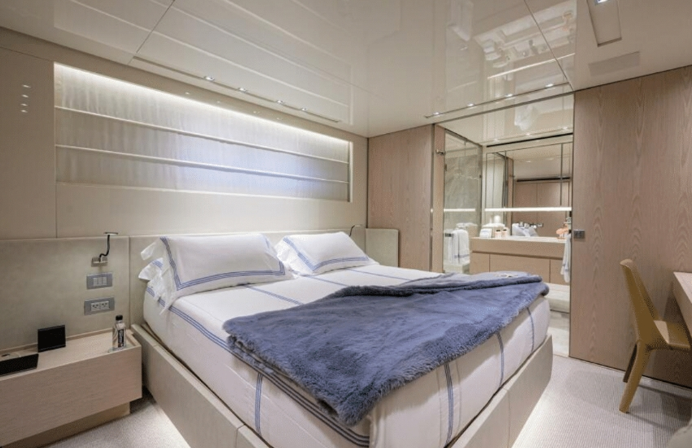

Slide 13
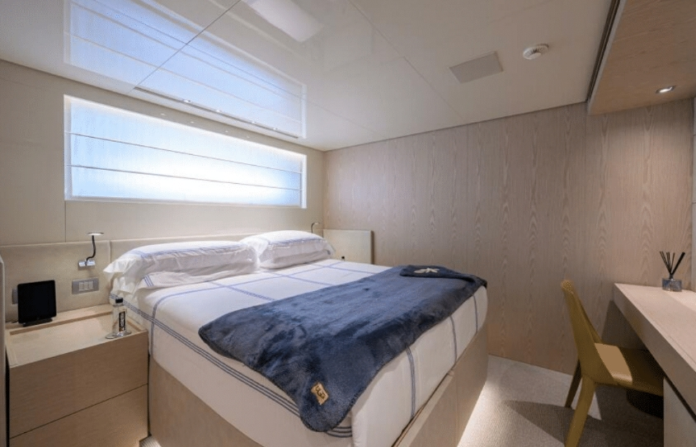
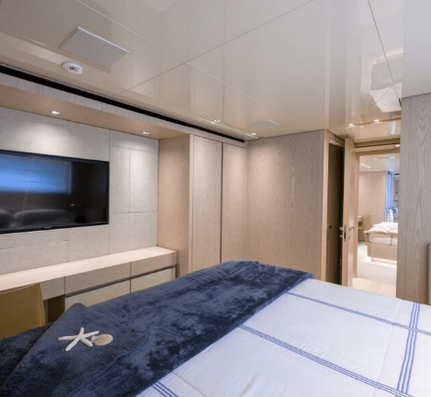
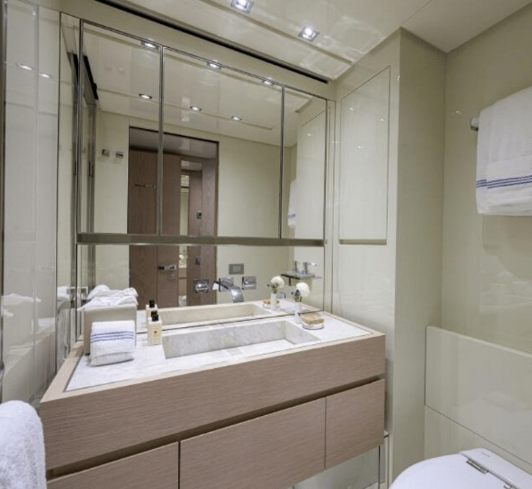

Slide 14
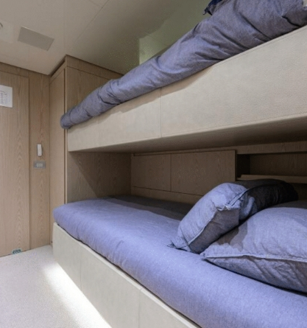

Slide 15
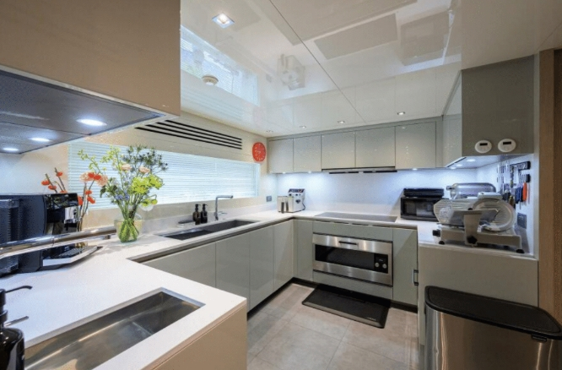
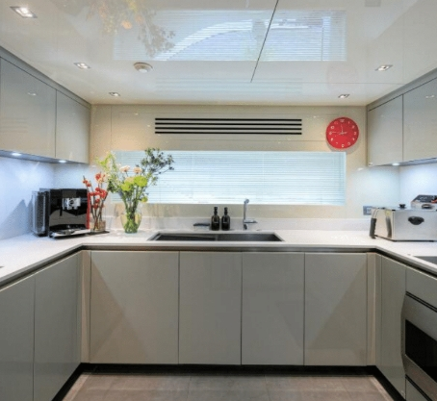
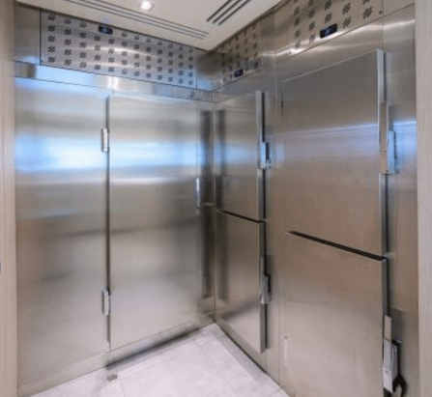

Slide 16
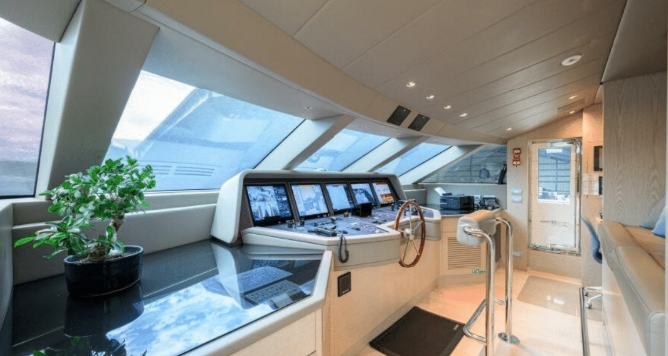
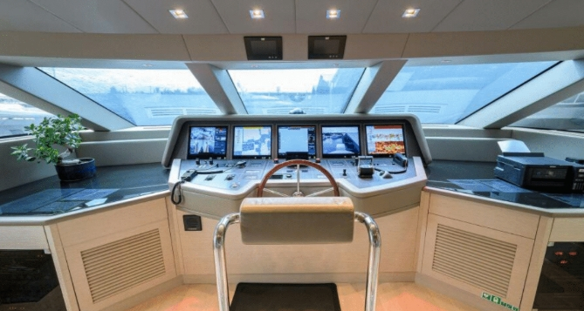

Slide 17
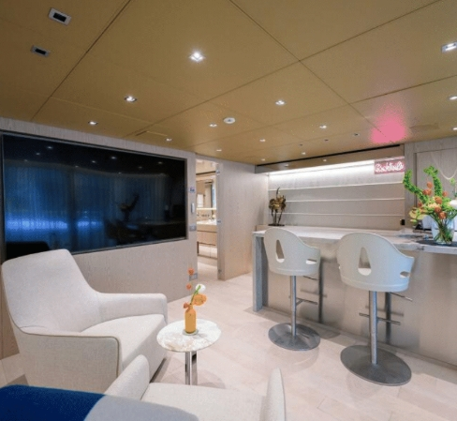
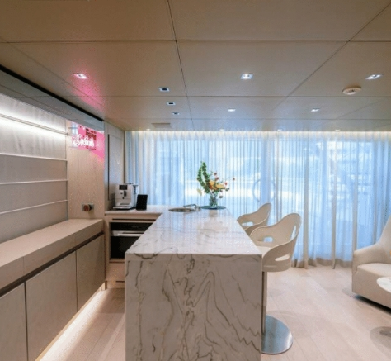
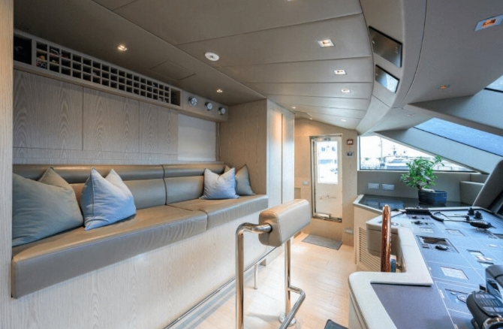

Slide 18
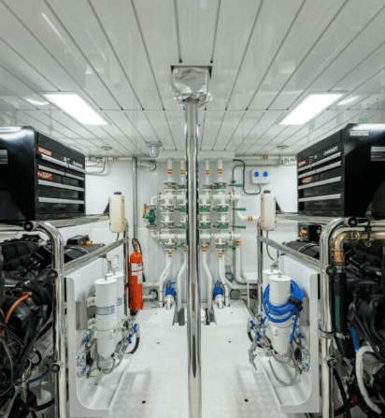
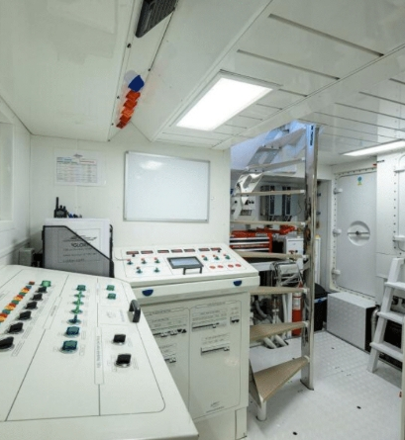
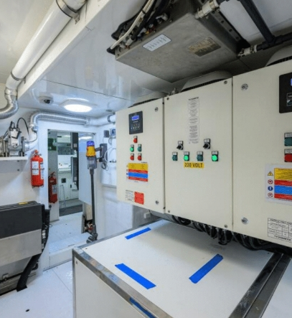
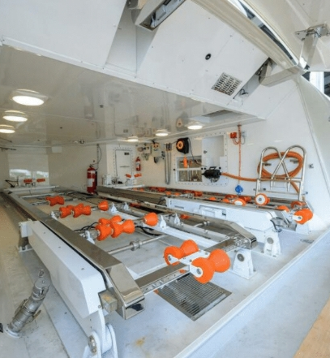

Slide 19
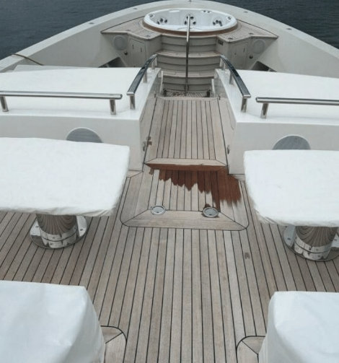

Slide 20
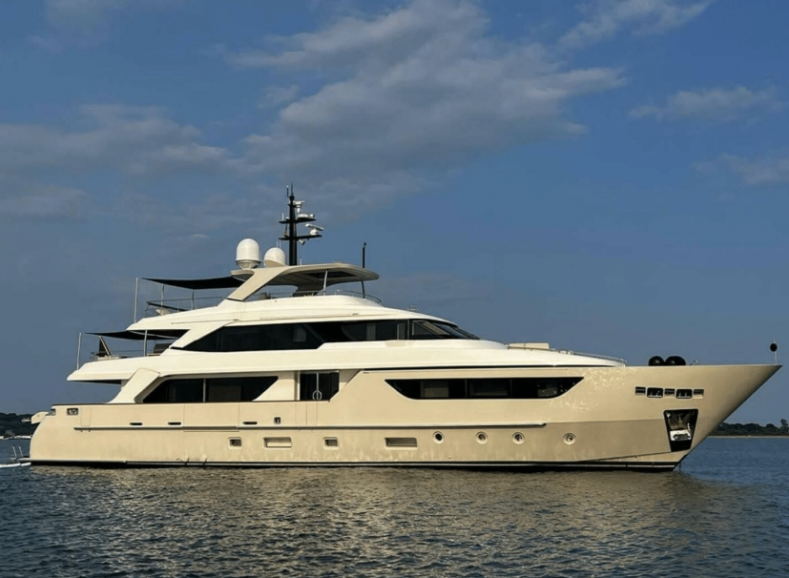

PEN MARINE SDN. BHD. IS THE REGISTERED AGENT OF THE
LANGKAWI INTERNATIONAL YACHT REGISTRY (LIYR)
New Yacht Registration (Private & Commercial), Entity Registration, Ownership Transfer, Yacht Name Change, Annual Tonnage Renewal, Deletion Certificate

Slide 21

This document is not contractual. Any information provided by the company on their website, brochure and any other related documentation is provided in good faith and offered for information purposed only and the company do not make any representation, warrant or assume any legal liability or responsibility whatsoever, express or implied, for the accuracy, adequacy, validity, reliability, availability, completeness or usefulness of any information and/or images displayed. Yacht inventory, sales and / or charter prices, and any other specifications are subject to changes at any time without prior notice. None of the text and/or image used in this brochure may be reproduced without written consent from the company.

